Slide 1

Case Study: Credit Card Transactions & Customer Profile Data
By: Win Phyo

Slide 2
Introduction
This project was conducted using data from Kaggle (original source: https://www.kaggle.com/datasets/ealtman2019/credit-card-transactions)
Two tables were imported to a local mysql database: 1) transactions, 2) users
The transaction data only considers non-fraudulent transactions and transactions no older then Jan 1, 2012

Slide 3
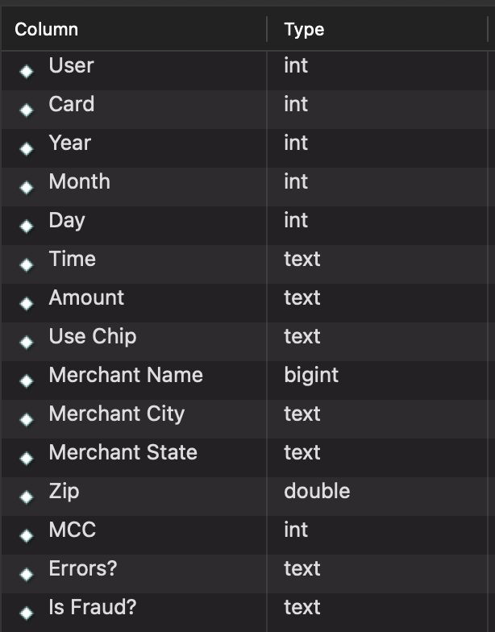
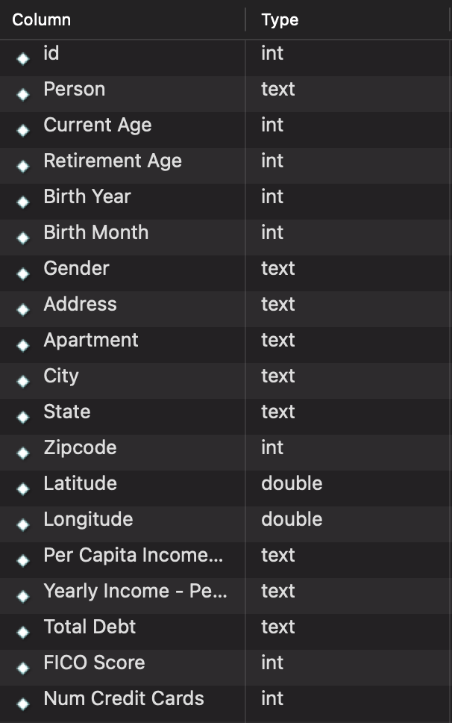
Table Schema
transactions
users

Slide 4
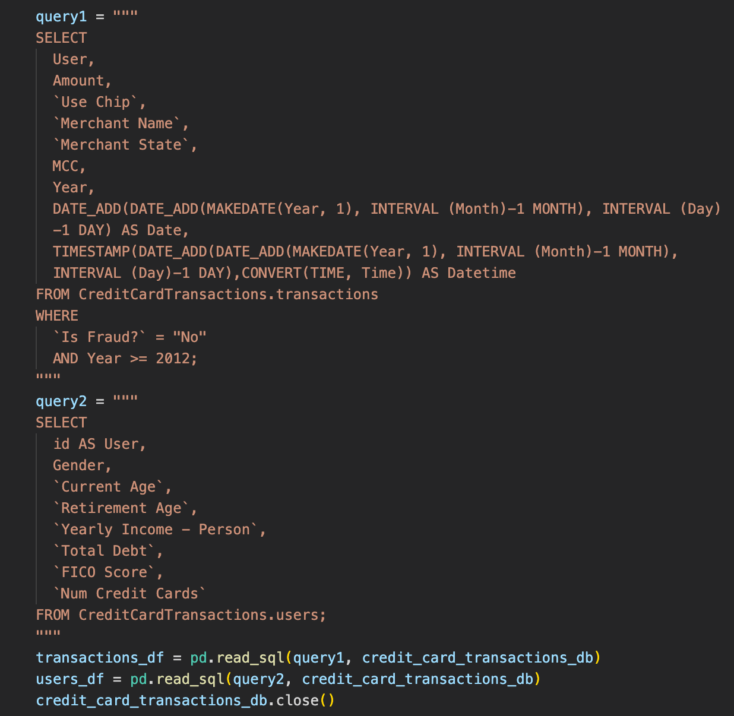
Query Definitions
We connected to the mysql database in our Python notebook environment using the mysql connector
The definitions for the initial queries are displayed to the right
See data-prep.ipynb for full details of all transformations/aggregations done to data before being imported to Power BI

Slide 5
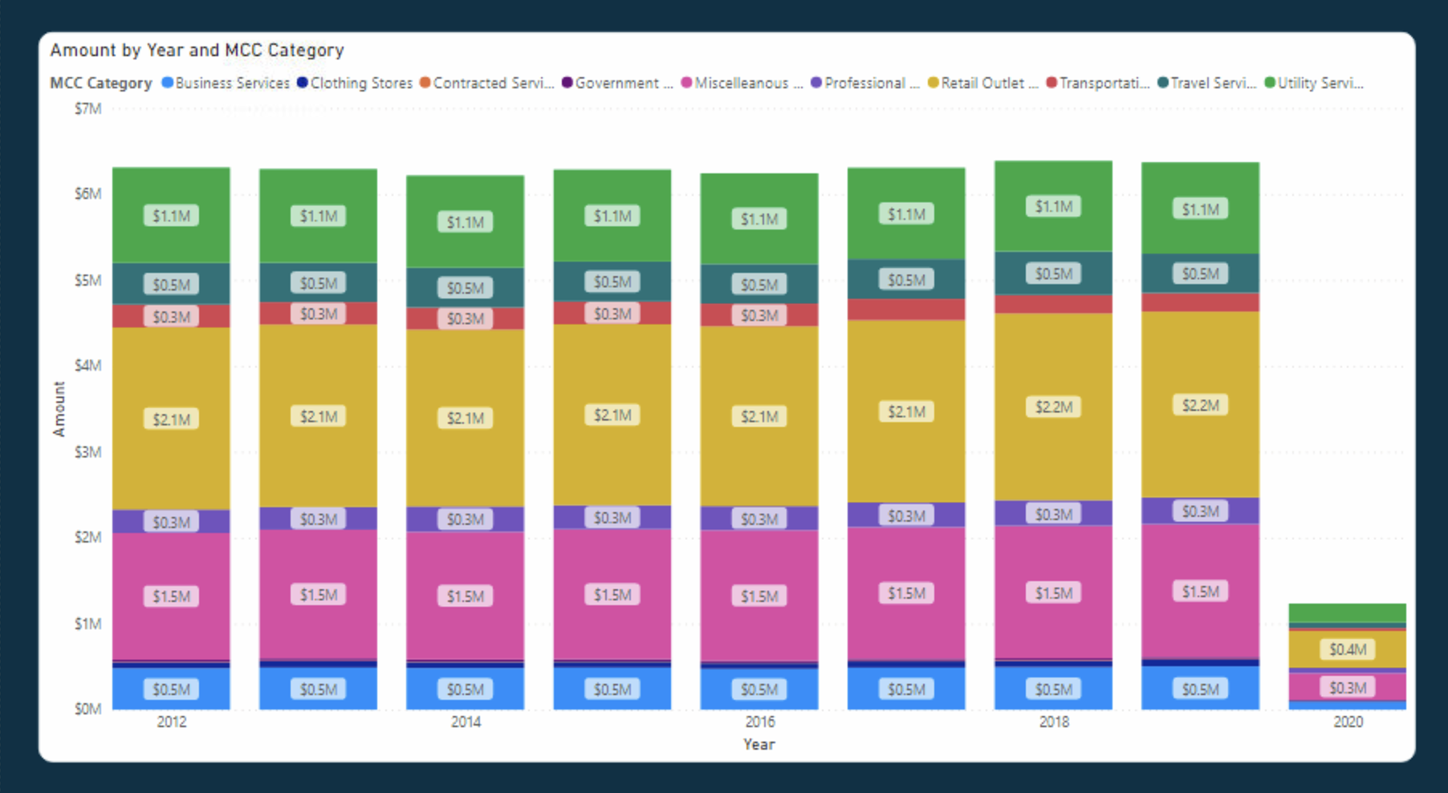
Time Series of Total Amount Spent by Category from 2012-2020
There were a lower volume of transactions represented in the data set for the year 2020.
Retail transactions consistently dominated total revenues for the 9 years

Slide 6
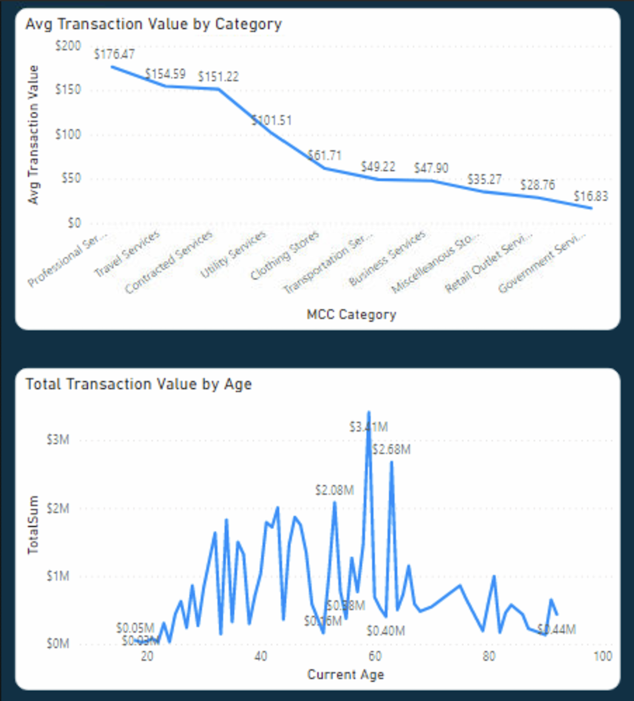
Some EDA
The Professional Services category was found to have the
transactions with the highest average value associated
with it
The 50-65 age group represented the greatest value in terms
of total transaction revenue

Slide 7
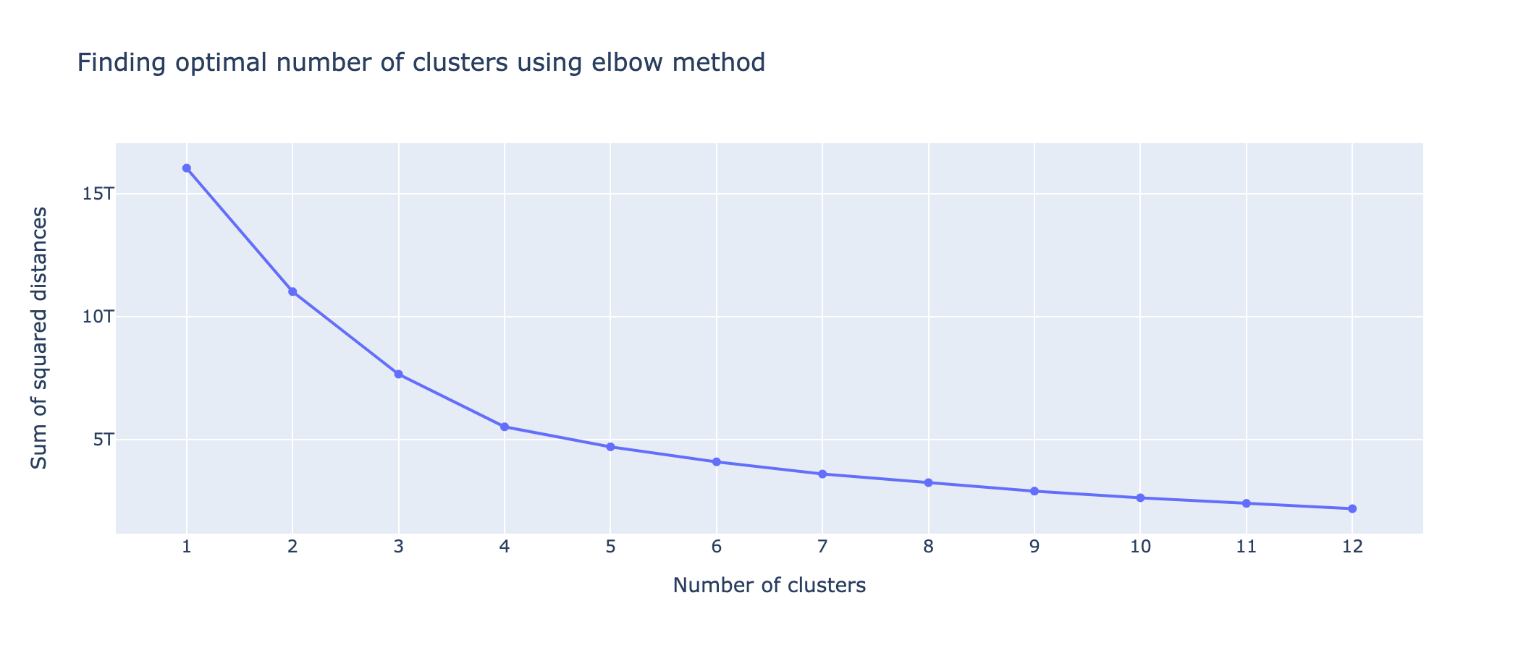
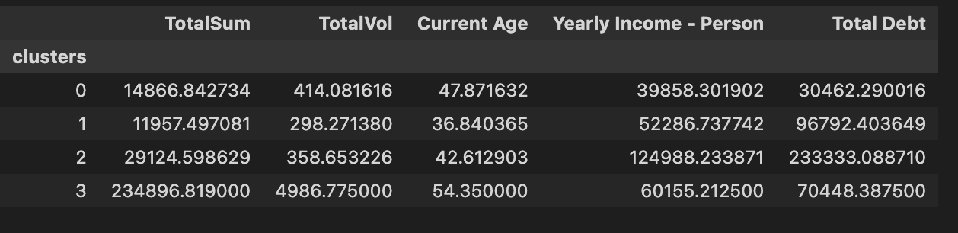
Simple K-Means Clustering
Using k=4, we used a simple K-Means Clustering algorithm to find 4 clusters with mean values as shown to the left

Slide 8
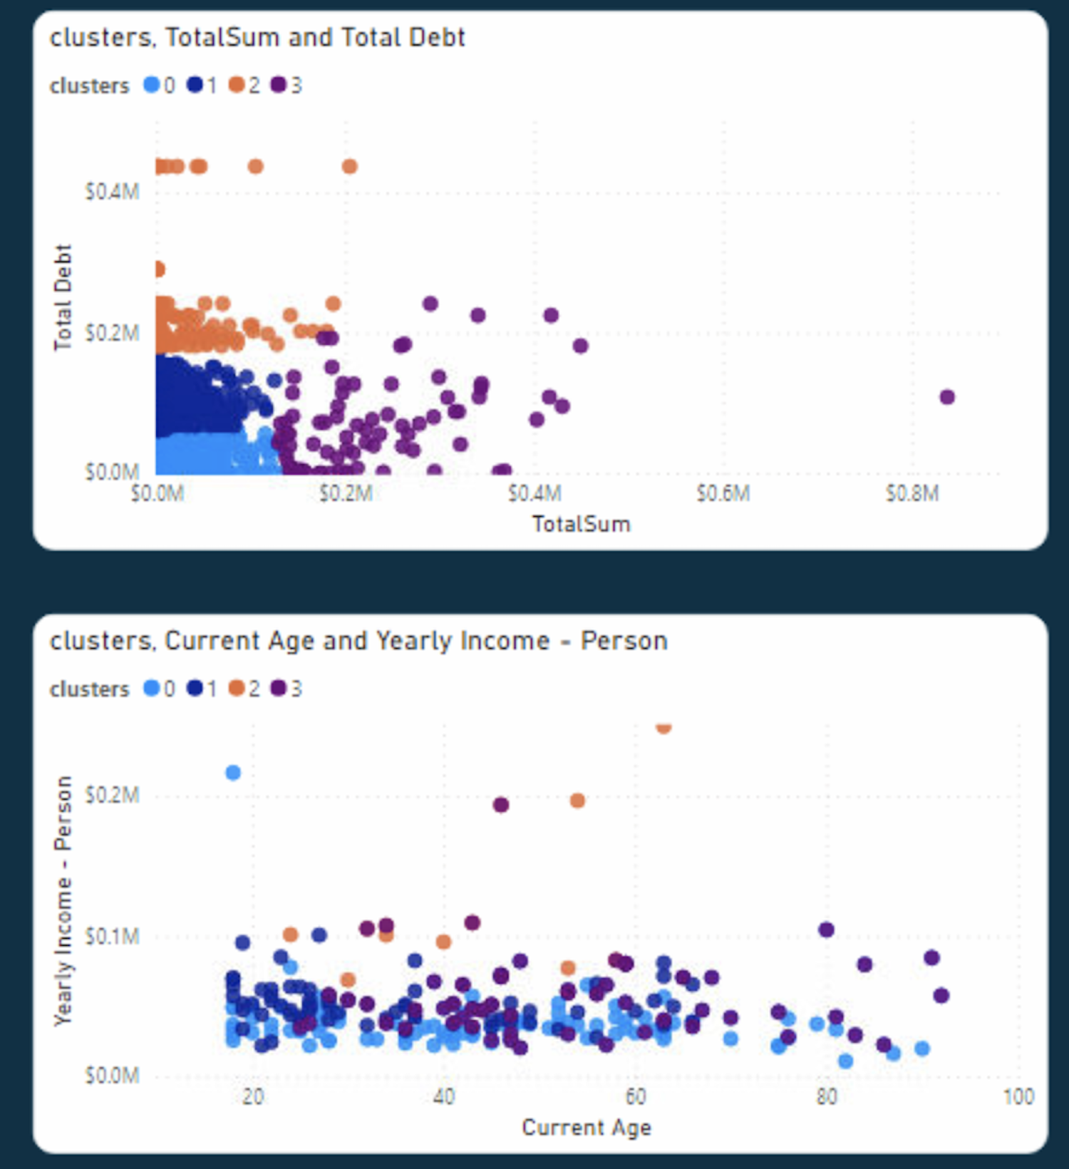
Cluster Visualizations
Where TotalSum = total value of transactions

Slide 9
Recommendations & Future Additions
Tailor marketing efforts based on the characteristics of each of the 4 clusters identified
Eg. Cluster 2 represents the current lowest total value of transactions, yet this group has comparable income to the 2nd highest income average by cluster, with ~$52,000 annual income. Avg total debt is higher as well, but cluster 2 also has the lowest average age, meaning they can be offered more long-term loans.
We can do more work with the MCC categories to identify more patterns in consumer spending to identify more tailored customer segments
We could also model consumer spending over time to forecast future purchases

